Slide 1
Transactions
Transaction Concept
Transaction State
Concurrent Executions
Serializability
Recoverability
Transaction Definition in SQL
Testing for Serializability.

Slide 2
What is a Transaction?
A logical unit of work on a database
–An entire program
–A portion of a program
–A single command
•The entire series of steps necessary to accomplish a logical unit of work
•Successful transactions change the database from one CONSISTENT STATE to another
(One where all data integrity constraints are satisfied)

Slide 3
All database access operations between Begin Transaction and End Transaction statements are considered one logical transaction.
If the database operations in a transaction do not update the database but only retrieve data, the transaction is called a read-only transaction.
Basic database access operations:
–read_item(X): reads a database item X into program variable.
–Write_item(X): Writes the value of program variable Xinto the database item X.

Slide 4
Example of a Transaction
Updating a Record
–Locate the Record on Disk
–Bring record into Buffer
–Update Data in the Buffer
–Writing Data Back to Disk

Slide 5
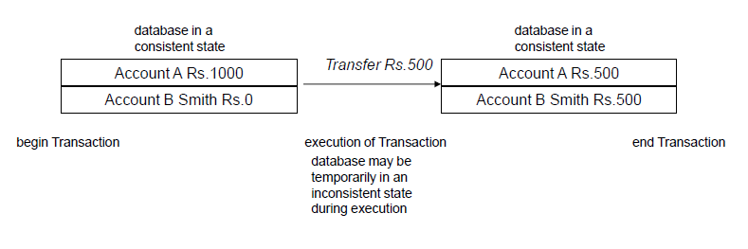
What is a transaction

Slide 6
ACID Properties
To preserve integrity of data, the database system must ensure:
Atomicity. Either all operations of the transaction are properly reflected in the database or none are.
Consistency. Execution of a transaction in isolation preserves the consistency of the database.
Isolation. Although multiple transactions may execute concurrently, each transaction must be unaware of other concurrently executing transactions. Intermediate transaction results must be hidden from other concurrently executed transactions.
That is, for every pair of transactions T_{i} and T_{j}, it appears to T_{i} that either T_{j}, finished execution before T_{i} started, or T_{j} started execution after T_{i} finished.
Durability. After a transaction completes successfully, the changes it has made to the database persist, even if there are system failures.

Slide 7
Example of Fund Transfer
Transaction to transfer $50 from account A to account B:
1. read(A)
2. A := A – 50
3. write(A)
4. read(B)
5. B := B + 50
6. write(B)
Consistency requirement – the sum of A and B is unchanged by the execution of the transaction.
Atomicity requirement — if the transaction fails after step 3 and before step 6, money will be “lost” leading to an inconsistent database state
Failure could be due to software or hardware
–the system should ensure that updates of a partially executed transaction are not reflected in the database

Slide 8
Example of Fund Transfer (Cont.)
Durability requirement — once the user has been notified that the transaction has completed (i.e., the transfer of the $50 has taken place), the updates to the database by the transaction must persist despite failures.

Slide 9
Example of Fund Transfer (Cont.)
Isolation requirement—if between steps 3 and 6, another transaction T2 is allowed to access the partially updated database, it will see an inconsistent database (the sum A + B will be less than it should be).
T1 T2
1.read(A)
2.A:= A –50
3.write(A)
read(A), read(B), print(A+B)
4.read(B)
5.B:= B + 50
6.write(B
•Isolation can be ensured trivially by running transactions serially
–that is, one after the other.
•However, executing multiple transactions concurrently has significant benefits, as we will see later.

Slide 10
Transaction State
Active, the initial state; the transaction stays in this state while it is executing
Partially committed, after the final statement has been executed.
Failed, after the discovery that normal execution can no longer proceed.
Aborted, after the transaction has been rolled back and the database restored to its state prior to the start of the transaction. Two options after it has been aborted:
restart the transaction – only if no internal logical error
kill the transaction
Committed, after successful completion.

Slide 11
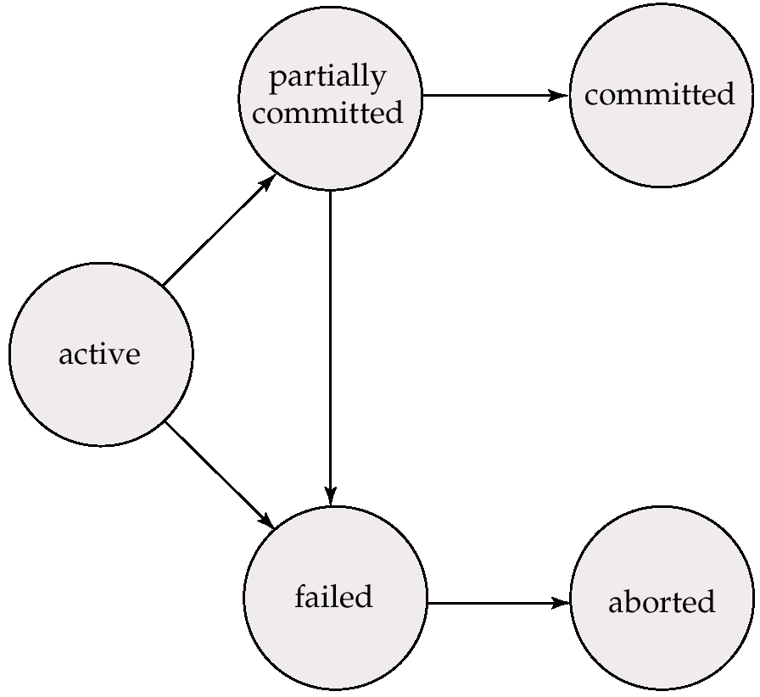
Transaction State (Cont.)

Slide 12
The System Log
The system maintains a log to keep track of all transaction operations that affect the values of database items.
This log may be needed to recover from failures.
Types of log records :
[start_transaction,T] : indicates that transaction T has started execution.
[write_item,T,X,old_value,new_value] : indicates that transaction T has changed the value of database item X from old_value to new_value. (new_value may not be recorded)
[read_item,T,X]: indicates that transaction T has read the value of database item X.
(read_item may not be recorded)
[commit,T]: transaction T has recorded permanently .
[abort,T]: indicates that transaction T has been aborted.

Slide 13
Transaction states and additional operations
READ/
WRITE
BEGIN
TRANSACTION
END
TRANSACTION
COMMIT
ACTIVE
PARTIALLY
COMMITTED
COMMITTED
ABORT
ABORT
FAILED
TERMINATED
State transition diagram illustrating the states for transaction execution

Slide 14
Concurrent Executions
Multiple transactions are allowed to run concurrently in the system. Advantages are:
increased processor and disk utilization, leading to better transaction throughput: one transaction can be using the CPU while another is reading from or writing to the disk
reduced average response time for transactions: short transactions need not wait behind long ones.
Concurrency control schemes – mechanisms to achieve isolation, i.e., to control the interaction among the concurrent transactions in order to prevent them from destroying the consistency of the database.

Slide 15
Schedules
Schedules – sequences that indicate the chronological order in which instructions of concurrent transactions are executed
a schedule for a set of transactions must consist of all instructions of those transactions
must preserve the order in which the instructions appear in each individual transaction.

Slide 16
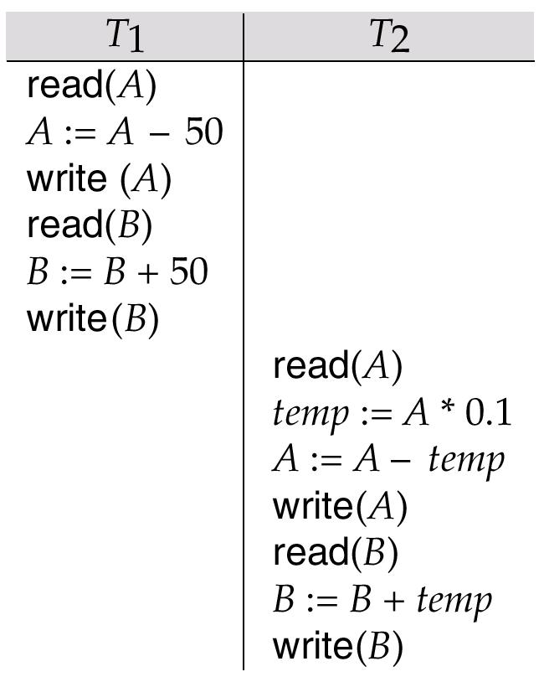
Example Schedules
Let T₁ transfer $50 from A to B, and T₂ transfer 10% of the balance from A to B. The following is a serial schedule (Schedule 1 in the text of the Korth book), in which T₁ is followed by T₂.

Slide 17
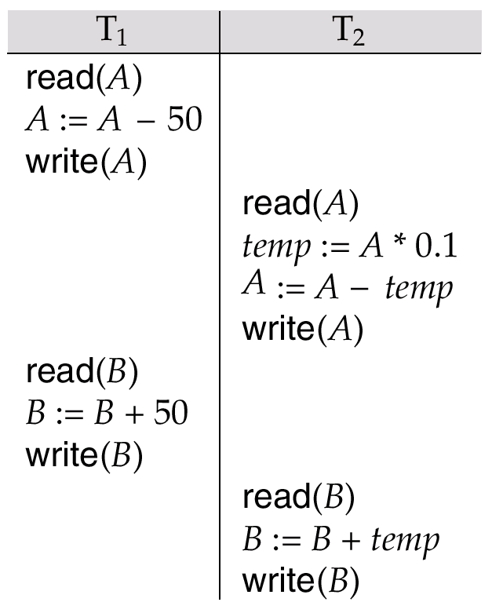
Example Schedule (Cont.)
Let T₁ and T₂ be the transactions defined previously. The following schedule (Schedule 3 in the text) is not a serial schedule, but it is equivalent to Schedule 1.
In both Schedule 1 and 3, the sum A + B is preserved.

Slide 18
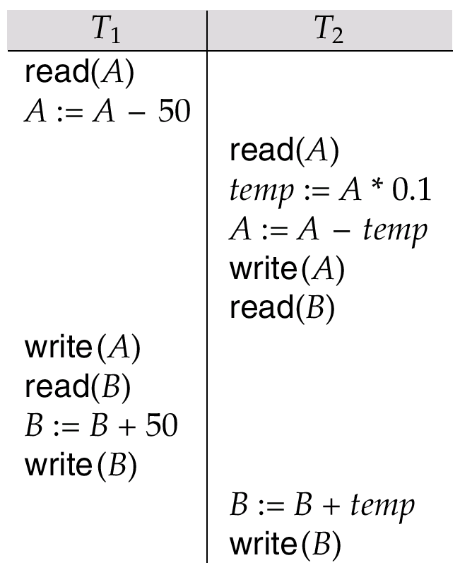
Example Schedules (Cont.)
The following concurrent schedule (Schedule 4 in the text) does not preserve the value of the the sum A + B.

Slide 19
Serializability
Basic Assumption – Each transaction preserves database consistency.
Thus serial execution of a set of transactions preserves database consistency.
A (possibly concurrent) schedule is serializable if it is equivalent to a serial schedule. Different forms of schedule equivalence give rise to the notions of:
1. conflict serializability
2. view serializability
We ignore operations other than read and write instructions, and we assume that transactions may perform arbitrary computations on data in local buffers in between reads and writes. Our simplified schedules consist of only read and write instructions.

Slide 20
Conflict Serializability
Instructions l_{i} and l_{j} of transactions T_{i} and T_{j} respectively, conflict if and only if there exists some item Q accessed by both l_{i} and l_{j}, and at least one of these instructions wrote Q.
1. l_{i} = read(Q), l_{j} = read(Q). l_{i} and l_{j} don’t conflict. 2. l_{i} = read(Q), l_{j} = write(Q). They conflict. 3. l_{i} = write(Q), l_{j} = read(Q). They conflict 4. l_{i} = write(Q), l_{j} = write(Q). They conflict
Intuitively, a conflict between l_{i} and l_{j} forces a (logical) temporal order between them. If l_{i} and l_{j} are consecutive in a schedule and they do not conflict, their results would remain the same even if they had been interchanged in the schedule.

Slide 21
CONCURRENT EXECUTIONS – CONFLICTING ACTIONS
What are the Anomalies Associated with Interleaved Execution? Let T1 and T2 be two consistency preserving transactions.
Now, if the actions of T1 and T2 are interleaved, then two action on the same data object conflict , if at least one of them is a write.
Possible conflicts are: 1. WRITE-READ (WR) CONFLICT 2. READ-WRITE (RW) CONFLICT 3. WRITE-WRITE (WW) CONFLICT

Slide 22
WR CONFLICT [READING UNCOMMITTED DATA ] When a transaction T2 could read a database object that has been modified by another transaction T1, which has not yet committed. Such a read is called dirty read.
RW CONFLICTS [UNREPEATABLE READS] When a transaction T2 changes the value of an object A that has been already read by a transaction T1, while T1 is still in progress. Problem:
If T1 tries to read the value of A again, it will get a different result, even though it has not modified A in the meantime. It is called an unrepeatable read.
WW CONFLICTS [OVERWRITING UNCOMMITTED DATA] When a transaction T2 could overwrite the value of an object A, which has already been modified by a transaction T1, while T1 is still in progress. Even if T2 does not read the value of A written by T1, a potential problem exists .

Slide 23
CONCURRENT EXECUTIONS – CONFLICTING ACTIONS – DIRTY READ
Example: Consider two transactions T1 and T2, each of which, run alone, preserves database consistency : Consider fund transfer from account A to B using following serial execution of T1 and T2: (The task is to transfer $100 from A to B and then increment the funds in A and B by 6%) 1. T1 transfers $100 from A to B 2. T2 increments both A and B by 6 percent. The database is consistent because the above schedule is serial. [Dirty Read] : Now, Suppose that their actions are interleaved as below: 1. T1 deducts $100 from account A, 2. T2 reads the current values of accounts A and B and adds 6 percent interest 3. The account transfer program credits $100 to account B The above schedule will not leave the database in a consistent state.

Slide 24
CONCURRENT EXECUTIONS – CONFLICTING ACTIONS – EXAMPLE
WW CONFLICTS (OVERWRITING UNCOMMITTED DATA) Suppose that Harry and Larry are two employees. Consistent criterion : Their salaries must be kept equal. Consider the following action of T1 and T2 each of which is consistency preserving: Actions of T1 : 1. set Harry’s salary to $1000. 2. set Larry’s salary to $1000 Actions of T2 : 1. set Harry’s salary to $2000. 2. set Larry’s salary to $2000 Any serial order of T1 and T2 , satisfies the Consistent criterion . Notice that neither transaction reads a salary value before writing it, such a write is called a blind write

Slide 25
WW CONFLICTS (OVERWRITING UNCOMMITTED DATA) Now, consider the following interleaving of the actions of T1 and T2: 1. T1 sets Harry's salary to $1,000 2. T2 sets Larry's salary to $2,000 3. T1 sets Larry's salary to $1,000 4. T2 sets Harry's salary to $2,000 It violates the desired consistency criterion that the two salaries must be equal. The result is not identical to the result of either of the two possible serial executions, and the interleaved schedule is therefore not serializable.

Slide 26
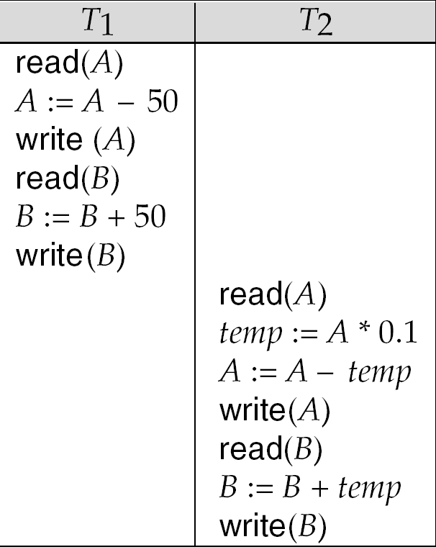
What is a serializable schedule ?
A schedule S whose effect on any consistent database instance is guaranteed to be identical to that of some complete serial schedule. i.e.
When an equivalent Complete Serial Schedule S’ is executed against a consistent database, the result is same.
Example: In foll. given two schedules, the database is consistent in both i.e. sum A+B is preserved
A SERIALIZABLE SCHEDULE
AN EQUIVALENT SERIAL SCHEDULE

Slide 27
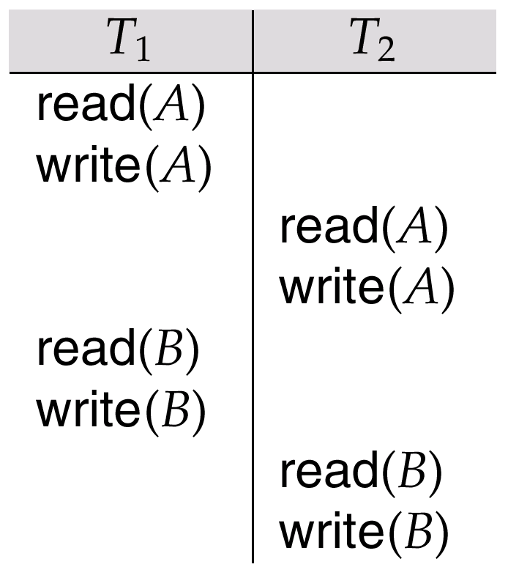
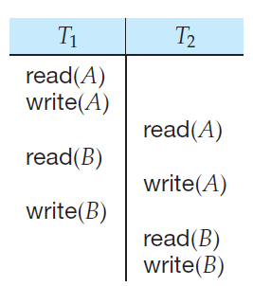
Conflict Serializability (Cont.)
If a schedule S can be transformed into a schedule S´ by a series of swaps of non-conflicting instructions, we say that S and S´ are conflict equivalent.
We say that a schedule S is conflict serializable if it is conflict equivalent to a serial schedule
Result equivalent Two schedules are called result equivalent if they produce the same final state of the database
Schedule A
Conflict Equivalent of schedule A

Slide 28
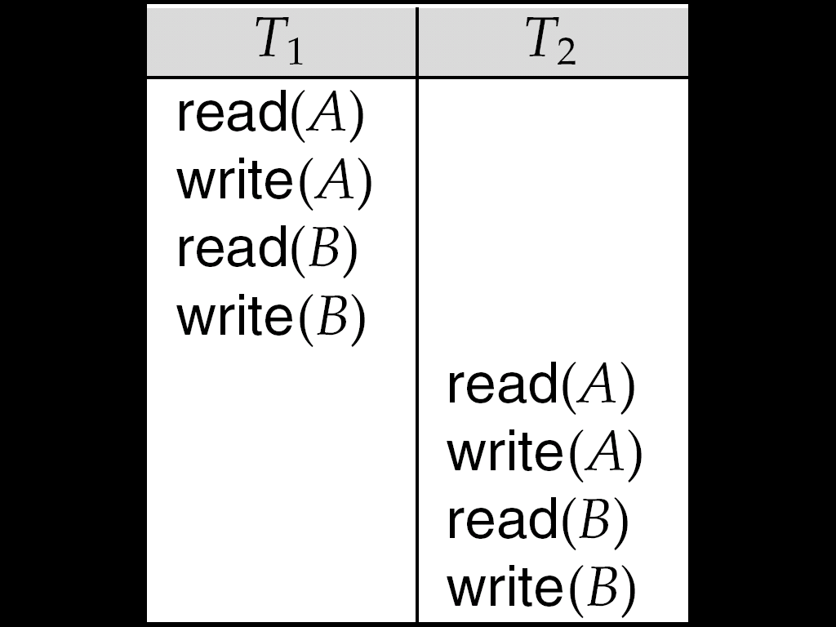
Conflict Serializability (Cont.)
Schedule 3 below can be transformed into Schedule 4, a serial schedule where T₂ follows T₁, by series of swaps of non-conflicting instructions. Therefore Schedule 3 is conflict serializable.
Schedule 3
Schedule 4

Slide 29
Example of a schedule that is not conflict serializable:
T₃ T₄ read(Q) write(Q) write(Q) We are unable to swap instructions in the above schedule to obtain either the serial schedule < T₃, T₄ >, or the serial schedule < T₄, T₃ >.

Slide 30
View Serializability
Let S and S´ be two schedules with the same set of transactions. S and S´ are view equivalent if the following three conditions are met:
1. For each data item Q, if transaction T_{i} reads the initial value of Q in schedule S, then transaction T_{i} must, in schedule S´, also read the initial value of Q.
2. For each data item Q if transaction T_{i} executes read(Q) in schedule S, and that value was produced by transaction T_{j} (if any), then transaction T_{i} must in schedule S´ also read the value of Q that was produced by transaction T_{j} .
3. For each data item Q, the transaction (if any) that performs the final write(Q) operation in schedule S must perform the final write(Q) operation in schedule S´.
As can be seen, view equivalence is also based purely on reads
and writes alone.

Slide 31
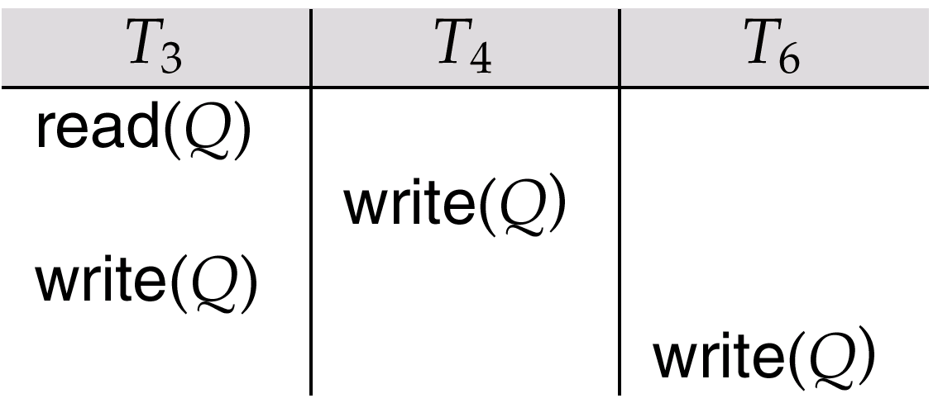
View Serializability (Cont.)
A schedule S is view serializable it is view equivalent to a serial schedule.
Every conflict serializable schedule is also view serializable.
Following Schedule 9 (from text) — a schedule which is view-serializable but not conflict serializable.
Every view serializable schedule that is not conflict serializable has blind writes.

Slide 32
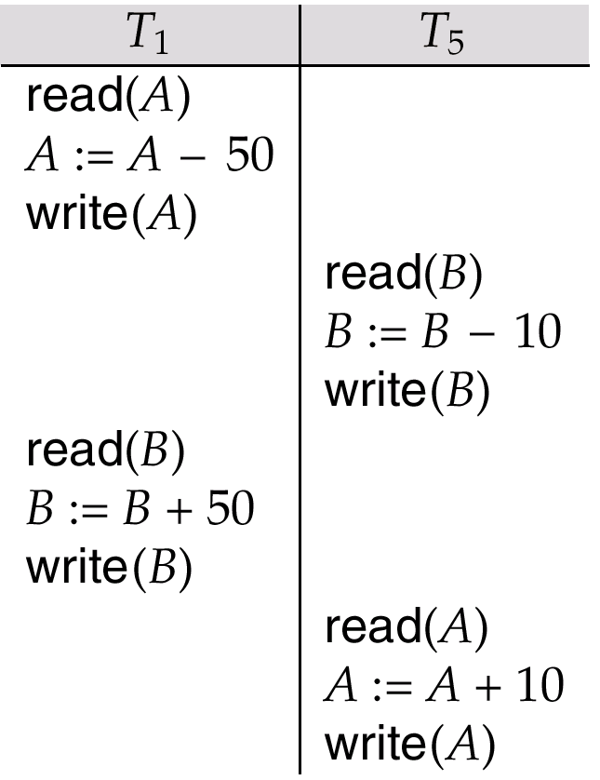
Other Notions of Serializability
Schedule 8 (from text) given below produces same outcome as the serial schedule < T₁, T₅ >, yet is not conflict equivalent or view equivalent to it.
Determining such equivalence requires analysis of operations other than read and write.

Slide 33
Testing for Serializability
Consider some schedule of a set of transactions T₁, T₂, ..., T_{n}
Precedence graph — a direct graph where the vertices are the transactions (names).
To draw one:
1) Draw a node for each transaction in the schedule
2) For each pair of following ordered conflict operations in S, create a directional arc in the same order
Ti Tj
W(X) R(X) create arc Ti -> Tj
R(X) W(X) create arc Ti -> Tj
W(X) W(X) create arc Ti -> Tj
We may label the arc by the item that was accessed.
y

Slide 34
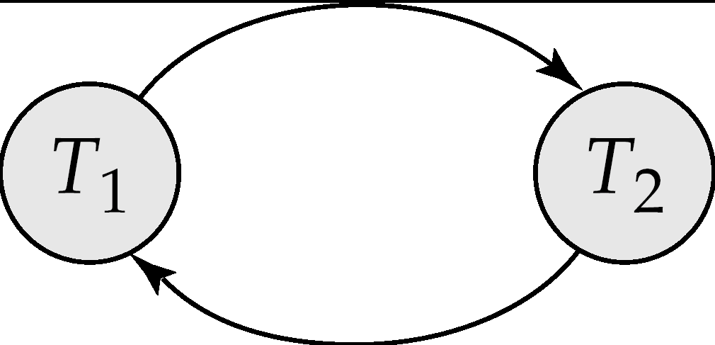
Example 1
T1 T2
READ(A)
READ(B)
READ(A)
READ(B)
WRITE(B)
WRITE(B)

Slide 35
Example Schedule (Schedule A) + Precedence Graph
T₁ T₂ T₃ T₄ T₅ read(X) read(Y) read(Z) read(V) read(W) read(W) read(Y) write(Y) write(Z) read(U) read(Y) write(Y) read(Z) write(Z)
read(U) write(U)
T₁
T₂
T₄
T₃
T₅

Slide 36
Test for Conflict Serializability
A schedule is conflict serializable if and only if its precedence graph is acyclic.
Cycle-detection algorithms exist which take order n² time, where n is the number of vertices in the graph. (Better algorithms take order n + e where e is the number of edges.)
If precedence graph is acyclic, the serializability order can be obtained by a topological sorting of the graph. This is a linear order consistent with the partial order of the graph. For example, a serializability order for Schedule A would be T₅ → T₁ → T₃ → T₂ → T₄ .

Slide 37
Test for View Serializability
The precedence graph test for conflict serializability must be modified to apply to a test for view serializability.
The problem of checking if a schedule is view serializable falls in the class of NP-complete problems. Thus existence of an efficient algorithm is unlikely. However practical algorithms that just check some sufficient conditions for view serializability can still be used.

Slide 38
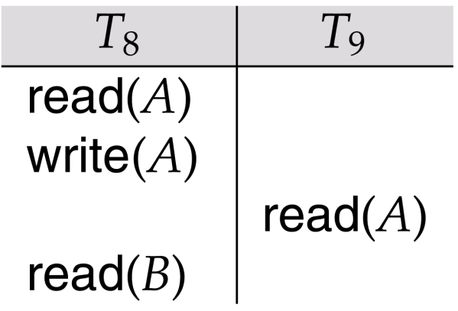
Recoverability
Need to address the effect of transaction failures on concurrently running transactions.
Recoverable schedule — if a transaction T_{j} reads a data items previously written by a transaction T_{i} , the commit operation of T_{i} appears before the commit operation of T_{j}.
The following schedule (Schedule 11) is not recoverable if T₉ commits immediately after the read
If T₈ should abort, T₉ would have read (and possibly shown to the user) an inconsistent database state. Hence database must ensure that schedules are recoverable.

Slide 39
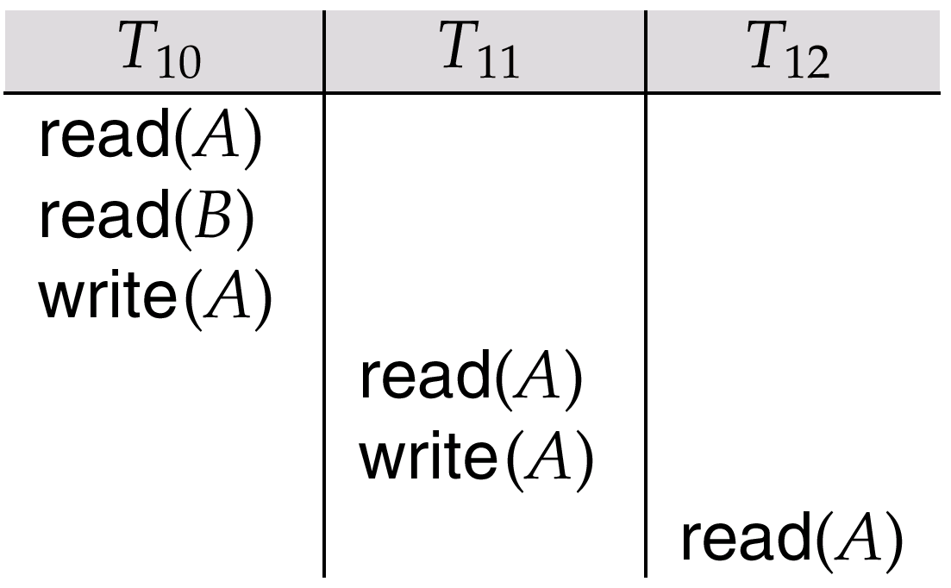
Recoverability (Cont.)
Cascading rollback – a single transaction failure leads to a series of transaction rollbacks. Consider the following schedule where none of the transactions has yet committed (so the schedule is recoverable) If T₁₀ fails, T₁₁ and T₁₂ must also be rolled back.
Can lead to the undoing of a significant amount of work

Slide 40
Recoverability (Cont.)
Cascadeless schedules — cascading rollbacks cannot occur; for each pair of transactions T_{i} and T_{j} such that T_{j} reads a data item previously written by T_{i}, the commit operation of T_{i} appears before the read operation of T_{j}.
Every cascadeless schedule is also recoverable
It is desirable to restrict the schedules to those that are cascadeless

Slide 41
Concurrency Control Protocols

Slide 42
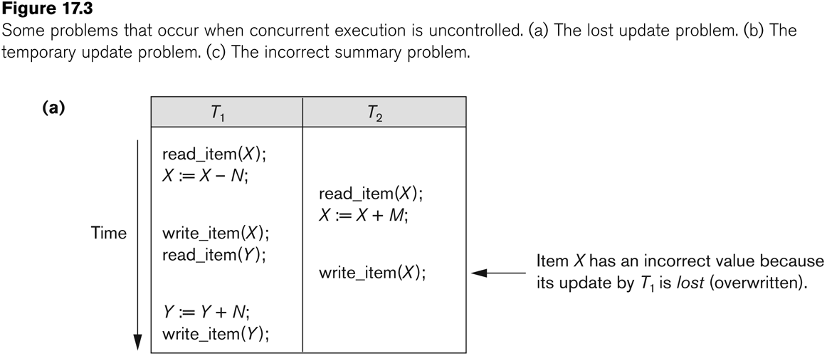
Why Concurrency Control is needed:
(a) The lost update problem.
This occurs when two transactions that access the same database items have their operations interleaved in a way that makes the value of some database item incorrect.

Slide 43
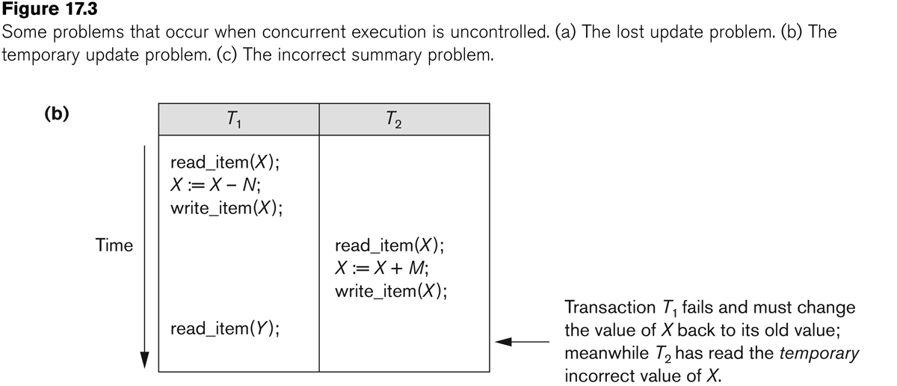
(b)The temporary update problem(Dirty Read Problem)
This occurs when one transaction updates a database item
and then the transaction fails for some reason
The updated item is accessed by another transaction before it
is changed back to its original value.

Slide 44
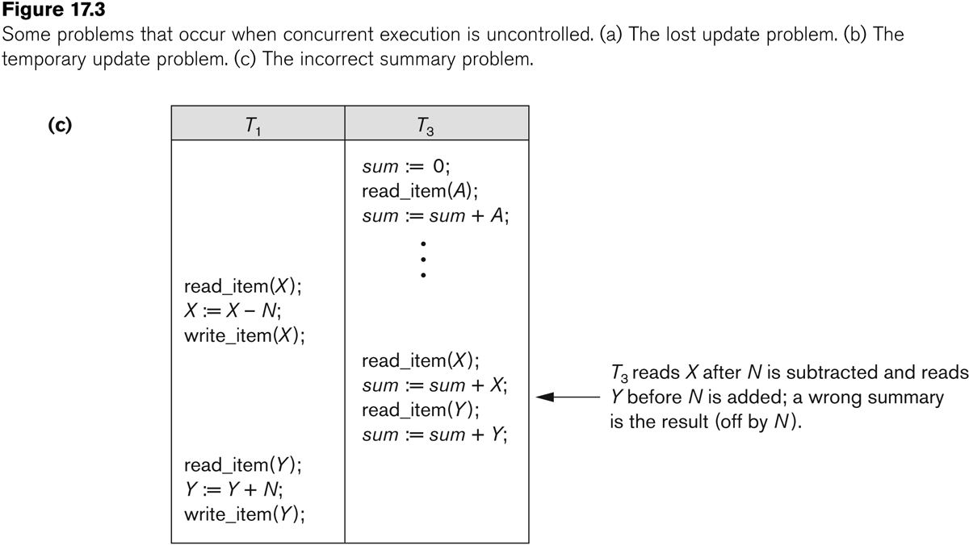
(c) The incorrect summary problem.
If one transaction is calculating an aggregate summary function on a number of records while other transactions are updating some of these records, the aggregate function may calculate some values before they are updated and others after they are updated.

Slide 45
Concurrency Control
A database must provide a mechanism that will ensure that all possible schedules are
either conflict or view serializable, and
are recoverable and preferably cascadeless
A policy in which only one transaction can execute at a time generates serial schedules, but provides a poor degree of concurrency
Are serial schedules recoverable/cascadeless? [Yes]
Testing a schedule for serializability after it has executed is a little too late!
Goal – to develop concurrency control protocols that will assure serializability.
Lock-based protocols
Timestamp-based protocols

Slide 46
Concurrency Control – Lock Manager
A Lock manager can be implemented as a separate process to which transactions send lock and unlock requests
The lock manager replies to a lock request by sending a lock grant messages (or a message asking the transaction to roll back, in case of a deadlock)
The requesting transaction waits until its request is answered
The lock manager maintains a data structure called a lock table to record granted locks and pending requests

Slide 47
Lock-Based Protocols
A lock is a mechanism to control concurrent access to a data item
Transactions ask for a lock on a record before updating it.
After update, the record is unlocked
Data items can be locked in two modes :
1. exclusive (X) mode. Data item can be both read as well as
written. X-lock is requested using lock-X instruction.
2. shared (S) mode. Data item can only be read. S-lock is
requested using lock-S instruction.
Lock requests are made to concurrency-control lock manager. Transaction can proceed only after request is granted.

Slide 48
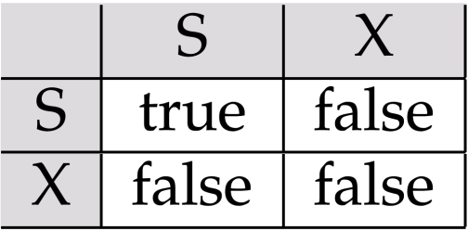
Lock-Based Protocols (Cont.)
Lock-compatibility matrix
A transaction may be granted a lock on an item if the requested lock is compatible with locks already held on the item by other transactions
Any number of transactions can hold shared locks on an item, but if any transaction holds an exclusive on the item no other transaction may hold any lock on the item.
If a lock cannot be granted, the requesting transaction is made to wait till all incompatible locks held by other transactions have been released. The lock is then granted.

Slide 49
Lock-Based Protocols (Cont.)
Example of a transaction performing locking:
T₂: lock-S(A);
read (A);
unlock(A);
lock-S(B);
read (B);
unlock(B);
display(A+B)

Slide 50
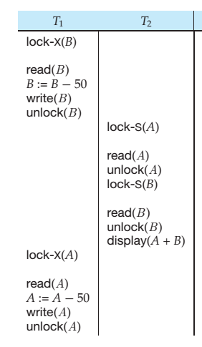
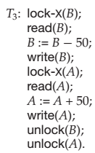
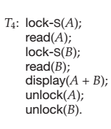
Lock-Based Protocols (Cont.)
Locking as above is not sufficient to guarantee serializability —As in this schedule (right side) if A and B get updated in-between the read of A and B, the displayed sum would be wrong.
One solution to this problem is to use delayed Unlocking .
This give rise to following transaction T3 and T4

Slide 51
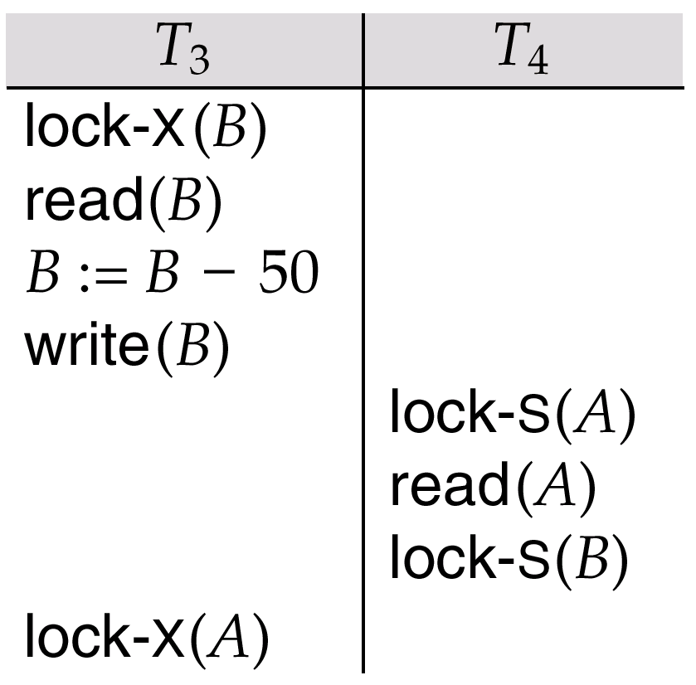
Pitfalls of Lock-Based Protocols
However, still T3 and T4 can lead to undesirable situation
Consider the partial schedule
Neither T₃ nor T₄ can make progress — executing lock-S(B) causes T₄ to wait for T₃ to release its lock on B, while executing lock-X(A) causes T₃ to wait for T₄ to release its lock on A.
Such a situation is called a deadlock.
To handle a deadlock one of T₃ or T₄ must be rolled back and its locks released.

Slide 52
Pitfalls of Lock-Based Protocols (Cont.)
Starvation is also possible if concurrency control manager is badly designed. For example:
A transaction may be waiting for an X-lock on an item, while a sequence of other transactions request and are granted an S-lock on the same item.
The same transaction is repeatedly rolled back due to deadlocks.
Concurrency control manager can be designed to prevent starvation.
Therefore
A locking protocol should be used, i.e, is a set of rules followed by all transactions while requesting and releasing locks. Locking protocols restrict the set of possible schedules.
The set of all such schedules is a proper subset of all possible serializable schedules.

Slide 53
The Two-Phase Locking Protocol
This is a protocol which ensures conflict-serializable schedules.
Phase 1: Growing Phase
transaction may obtain locks
transaction may not release locks
Phase 2: Shrinking Phase
transaction may release locks
transaction may not obtain locks
The protocol assures serializability. It can be proved that the transactions can be serialized in the order of their lock points (i.e. the point where a transaction acquired its final lock).
The transactions T3 and T4 are in Two-phase. The unlock instruction in T3 can be moved to just after the Lock-X(A) , and still maintaining the two-phase property

Slide 54
The Two-Phase Locking Protocol (Cont.)
Two-phase locking does not ensure freedom from deadlocks
Cascading roll-back is possible under two-phase locking. To avoid this, follow a modified protocol called strict two-phase locking. Here a transaction must hold all its exclusive locks till it commits/aborts.
Rigorous two-phase locking is even stricter: here all locks are held till commit/abort. In this protocol transactions can be serialized in the order in which they commit.

Slide 55
The Two-Phase Locking Protocol (Cont.)
There can be conflict serializable schedules that cannot be obtained if two-phase locking is used.
However, in the absence of extra information (e.g., ordering of access to data), two-phase locking is needed for conflict serializability in the following sense:
Given a transaction T_{i} that does not follow two-phase locking, we can find a transaction T_{j} that uses two-phase locking, and a schedule for T_{i} and T_{j} that is not conflict serializable.

Slide 56
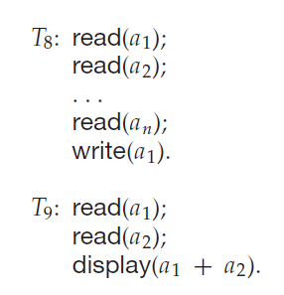
Lock-Conversions
Consider the following Schedule
If we employ the two-phase locking protocol, then T8 must lock a1 in exclusive mode. Therefore, any concurrent execution of both transactions amounts to a
serial execution.
if T8 could initially lock a1 in shared mode, and then could later change the lock to exclusive mode, we could get more concurrency, since T8 and T9 could access a1 and a2 simultaneously
This refinement give rise to refined Two-phase locking protocol in which lock-conversions are allowed

Slide 57
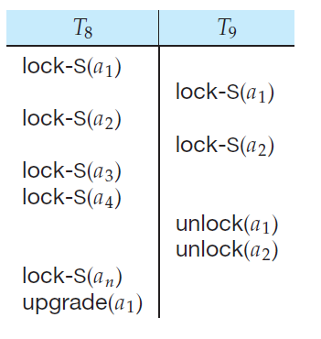
Lock-Conversions (Refined Two-phase locking protocol
In this protocol, a mechanism is provided for upgrading a shared lock to an exclusive lock, and downgrading an exclusive lock to a shared lock.
The conversion from shared to exclusive modes is denoted by upgrade, and from exclusive to shared by downgrade
Upgrading can take place in only the growing phase, whereas downgrading can take place in only the shrinking phase.
Modified partial Schedule is shown as below :

Slide 58
Examples (Precedence Graph)
Assume we have these three transactions:
T1: r₁(x);w₁(x);r₁(y);w₁(y)
T2: r₂(z);r₂(y);w₂(y);r₂(x);w₂(x)
T3: r₃(y);r₃(z);w₃(y);w₃(z)
Assume we have these schedule:
S1: r₂(z);r₂(y);w₂(y); r₃(y);r₃(z); r₁(x);w₁(x); w₃(y);w₃(z);r₂(x); r₁(y);w₁(y); w₂(x)
No equivalent serial schedule
(cycle x(T₁→T₂),y(T₂→T₁))
(cycle x(T₁→T₂),yz(T₂→T₃),y(T₃→T₁))
y
T₁
T₂
x
y
y,z
T₃

Slide 59
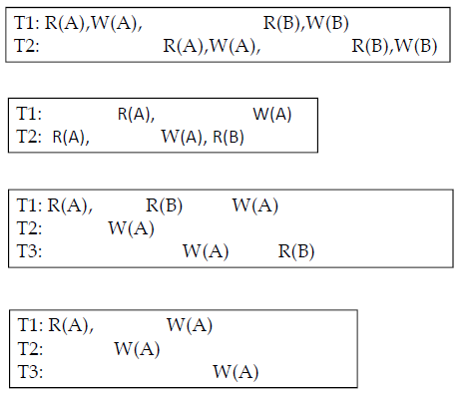
Do it yourself: Which of these is serializable?

Slide 60
Deadlock Handling

Slide 61
Pitfalls of Lock-Based Protocols
Following transactions T3 and T4 can lead to undesirable situation
Consider the partial schedule
Neither T₃ nor T₄ can make progress — executing lock-S(B) causes T₄ to wait for T₃ to release its lock on B, while executing lock-X(A) causes T₃ to wait for T₄ to release its lock on A.
Such a situation is called a deadlock.
To handle a deadlock one of T₃ or T₄ must be rolled back and its locks released.

Slide 62
Pitfalls of Lock-Based Protocols (Cont.)
The potential for deadlock exists in most locking protocols. Deadlocks are a necessary evil.
Starvation is also possible if concurrency control manager is badly designed. For example:
A transaction may be waiting for an X-lock on an item, while a sequence of other transactions request and are granted an S-lock on the same item.
As a transaction will not get X-lock until other transactions release S-lock on that item. Therefore, the same transaction is repeatedly rolled back due to deadlocks.
Concurrency control manager can be designed to prevent starvation.

Slide 63
Deadlock Handling
System is deadlocked if there is a set of transactions such that every transaction in the set is waiting for another transaction in the set, i.e., consider a set of transactions (T1, T2, T3, ……Tn-1, Tn) such that T1 is waiting for T2 , T2 is waiting for T3 and so on and Tn-1 is waiting for Tn and Tn is waiting for T1.
Deadlock prevention protocols ensure that the system will never enter into a deadlock state. It is used when probability of system in entering a deadlock state is high. Some prevention strategies :
Require that each transaction locks all its data items before it begins execution (predeclaration).
Impose partial ordering of all data items and require that a transaction can lock data items only in the order specified by the partial order (graph-based protocol).

Slide 64
More Deadlock Prevention Strategies
Following schemes use transaction timestamps for the sake of deadlock prevention alone.
wait-die scheme — non-preemptive
older transaction may wait for younger one to release data item. Younger transactions never wait for older ones; they are rolled back instead.
a transaction may die several times before acquiring needed data item
wound-wait scheme — preemptive
older transaction wounds (forces rollback) of younger transaction instead of waiting for it. Younger transactions may wait for older ones.
may be fewer rollbacks than wait-die scheme.

Slide 65
Deadlock prevention (Cont.)
Both in wait-die and in wound-wait schemes, a rolled back transactions is restarted with its original timestamp. Older transactions thus have precedence over newer ones, and starvation is hence avoided.
Timeout-Based Schemes :
a transaction waits for a lock only for a specified amount of time. After that, the wait times out and the transaction is rolled back.
thus deadlocks are not possible
simple to implement; but starvation is possible. Also difficult to determine good value of the timeout interval. Too long timeout interval results into unnecessary delays once a deadlock has occurred . Too short results in transaction rollback even when there is no deadlock, leading to wasted resources.

Slide 66
Deadlock Detection
Deadlocks can be described as a wait-for graph, which consists of a pair G = (V,E),
V is a set of vertices (all the transactions in the system)
E is a set of edges; each element is an ordered pair T_{i} →T_{j}.
If T_{i} → T_{j} is in E, then there is a directed edge from T_{i} to T_{j}, implying that T_{i} is waiting for T_{j} to release a data item.
When T_{i} requests a data item currently being held by T_{j}, then the edge T_{i} T_{j} is inserted in the wait-for graph. This edge is removed only when T_{j} is no longer holding a data item needed by T_{i}.
The system is in a deadlock state if and only if the wait-for graph has a cycle. Must invoke a deadlock-detection algorithm periodically to look for cycles.

Slide 67
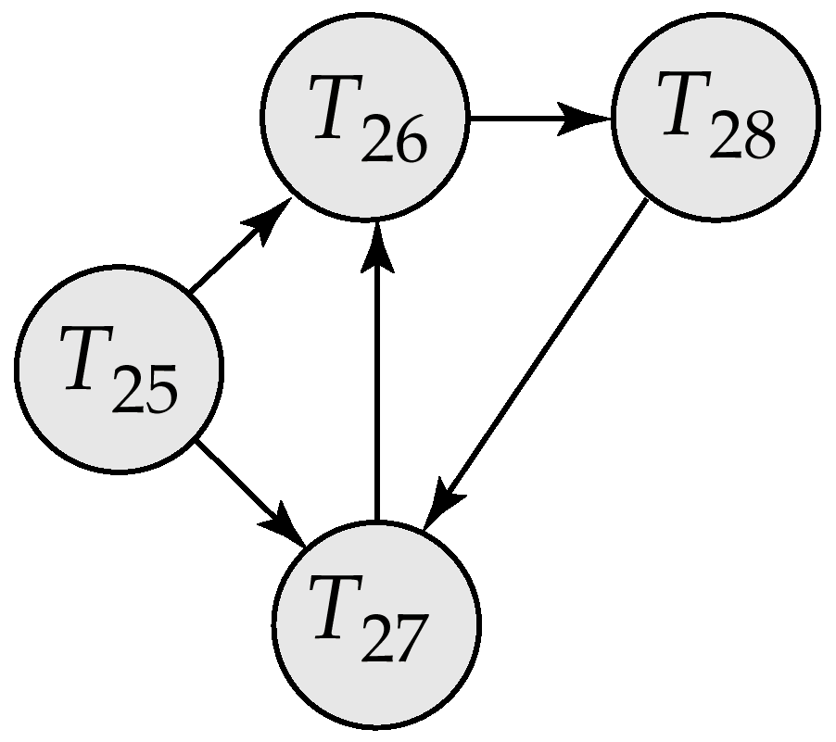
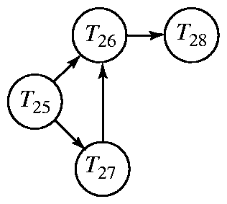
Deadlock Detection (Cont.)
Wait-for graph without a cycle
Wait-for graph with a cycle

Slide 68
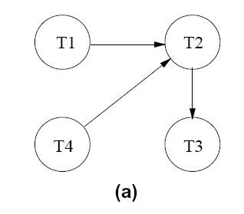
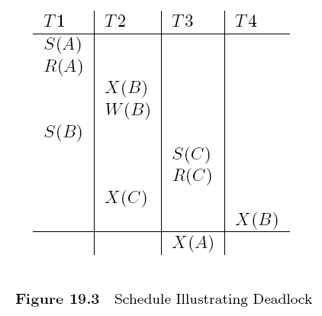
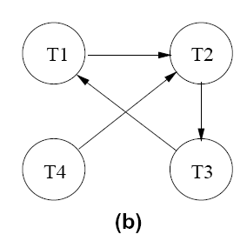
CONCURRENCY CONTROL PROTOCOLS – DEADLOCK DETECTION
Consider the schedule shown in Figure 19.3.
The last step, shown below the line, creates a cycle in the wait-for graph.

Slide 69
Deadlock Recovery
When deadlock is detected :
Some transaction will have to rolled back (made a victim) to break deadlock. Select that transaction as victim that will incur minimum cost i.e., how long transaction has computed, how much require to complete, number of data items affected, number of transactions will be involved in rollback.
Rollback -- determine how far to roll back transaction
Total rollback: Abort the transaction and then restart it.
More effective to roll back transaction only as far as necessary to break deadlock. Such partial rollback requires the system to maintain additional information about the state of all the running transactions. Specifically, the sequence of lock requests/grants and updates performed by the transaction needs to be recorded.
Starvation happens if same transaction is always chosen as victim. Include the number of rollbacks in the cost factor to avoid starvation

